Slide 1
Learning Management System
Democratic Team organization
Jesus Banda, Eric Martinez, Lim Nguyen, simon Phan, Tyler Thornton

Slide 2

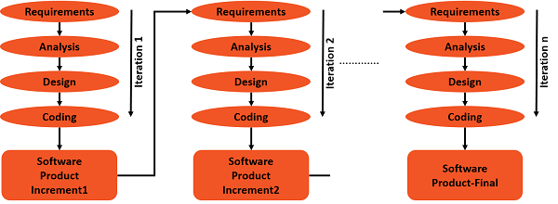



Iteration and Incrementation Model

Slide 3
What a Learning Management System is
This system will be similar to Blackboard, which is a typical learning management system. Learning management systems deal with all kinds of student details, academic related reports, college details, course details, curriculum, and other resource related details
The learning management system is a system that supports learning process of teaching and learning in the school. Student can view their courses, exam grades, and their GPA. Administrator can manage students by registering or dropping them from a course, entering exam grades, and adding or deleting them.

Slide 4
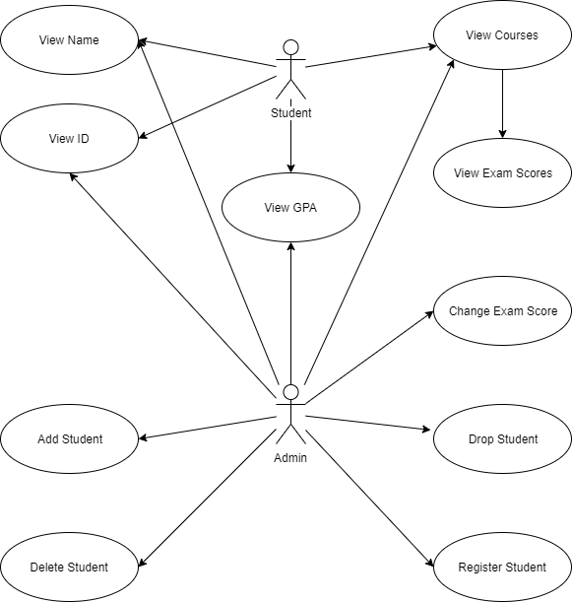
Use Case Diagram

Slide 5
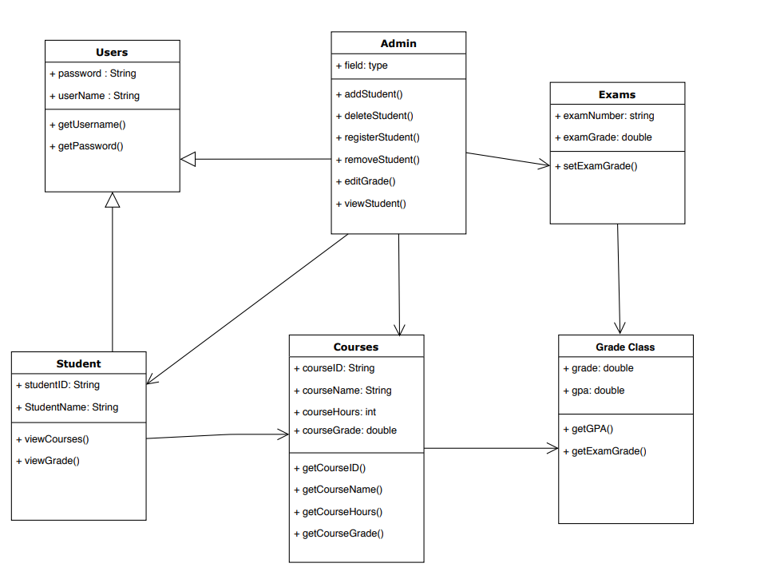
UML Class Diagram

Slide 6

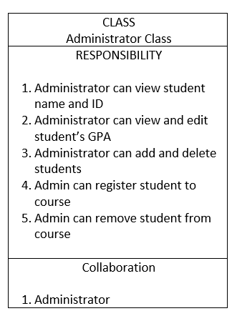
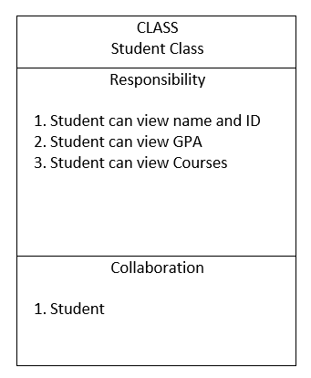
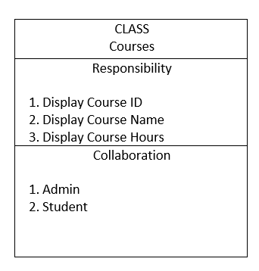
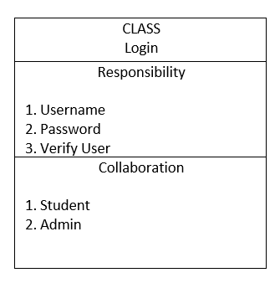
Class-Responsibility-Collaboration Cards

Slide 7
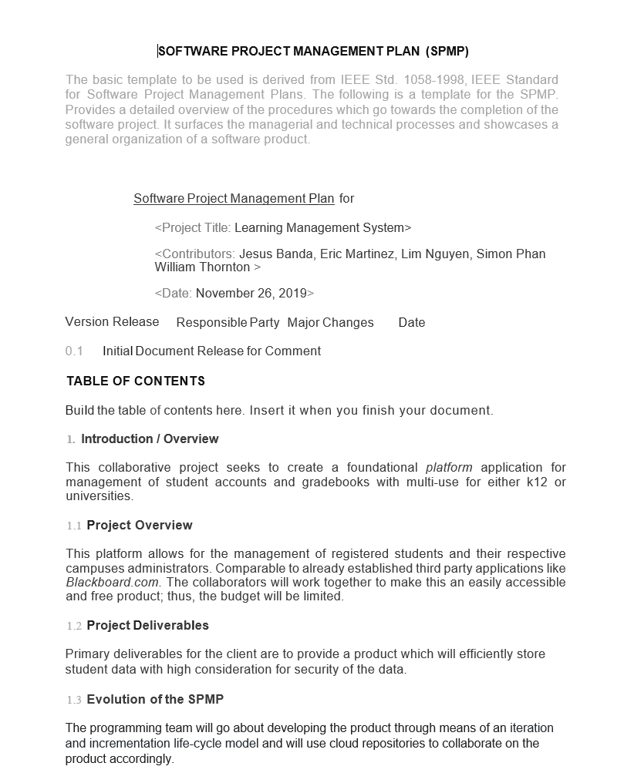
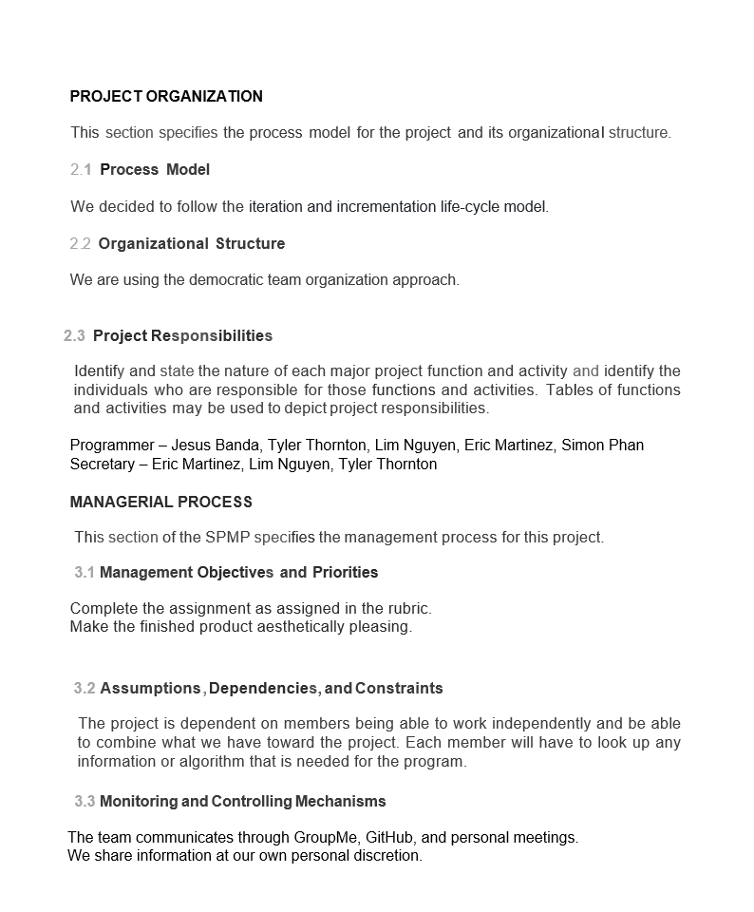
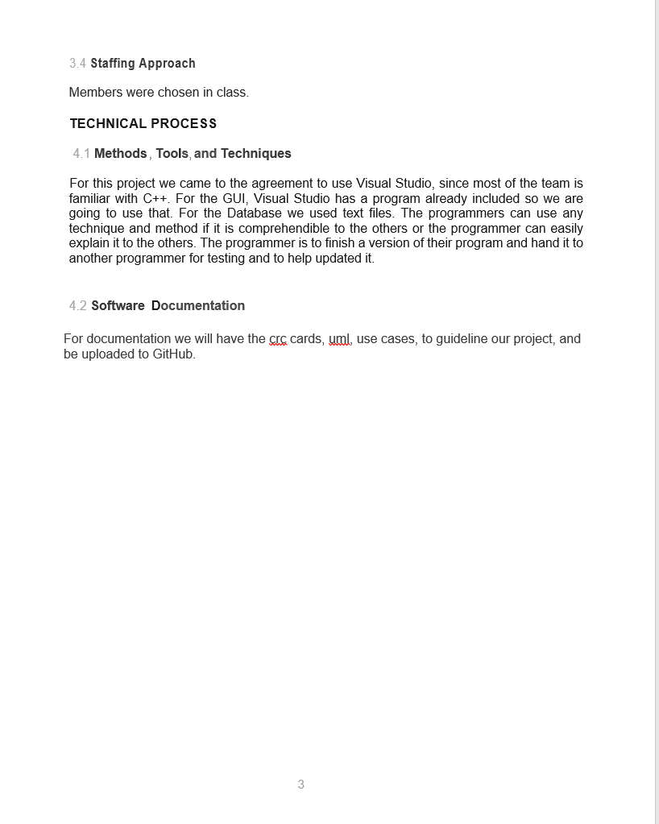
Software Project Management Plan

Slide 8
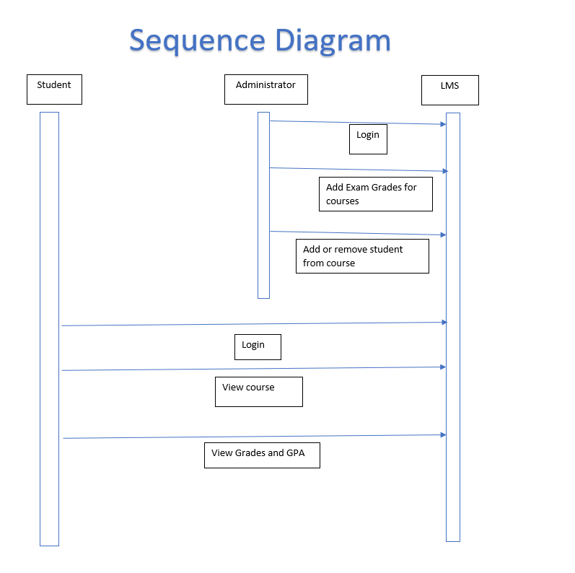

Slide 9
GitHub
https://github.com/soultechccm/Cs3321-Falls-2019

